Slide 1
DHE Learning Outcomes Assessment: Looking Backwards, Going Forward
Dr. Robert Awkward, Director of Learning Outcomes Assessment
September 28, 2018

Slide 2
Looking Backwards, Going Forward
A Review of 2017-2018
Amcoa Team Survey Feedback
DHE Website/Student Learning Outcomes
Planning for 2018-2019
This Photo by Unknown Author is licensed under CC BY-SA

Slide 3
Looking Backwards
Amcoa Team Meetings:
Sept. 29: Dr. Jonathan Gyurko, ACUE
Nov. 30: Dr. Mark Nicholas, Framingham State, “Academic Program Assessment: The Nuts & Bolts”
Feb. 2: Colleen Malloy, Portfolium
March 29: Dr. Julie Johnson, Faculty Guild
Task Force on Statewide Assessment:
Oct. 17: Dr. Douglas Roscoe, University of Massachusetts Dartmouth
Jan. 18: Multi-State Collaborative (MSC) Results & The Status of the MSC
March 9: Continuing Challenges for Assessment: A Point-Counterpoint Discussion

Slide 4
Looking Backwards: Amcoa Participant Survey
SurveyMonkey
June 2018
47% response rate
Question No. | Question | Very Satisfied | Satisfied
1 | Your experience | 28% | 53%
2 | Amcoa’s role | 54% | 34%
3 | Worcester location | 33% | 36%
4 | Meeting Time | 56% | 28%
5 | Four meetings | 46% | 49%

Slide 5
Looking Backwards: Amcoa Participant Survey
Clear preference is to learn from each other versus vendors with whom we have no money to buy
The exception was ACUE due to its relevance
Question No. | Question | Very Satisfied | Satisfied
6 | ACUE | 30% | 30%
7 | The Nuts & Bolts | 71% | 23%
8 | Portfolium | 18% | 43%
9 | Faculty Guild | 17% | 33%

Slide 6
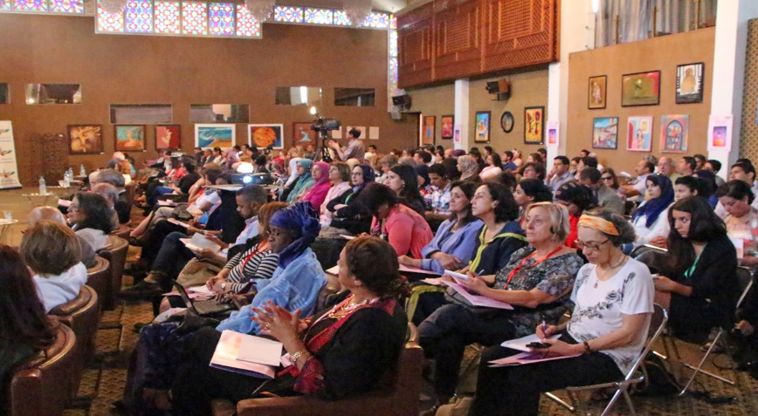
Looking Backwards
Seventh Annual Assessment Conference
“The Continuing Importance of Assessment: From Classroom to Program to Institutional levels”
Friday, April 20, 2018 @ Doubletree by Hilton, Westborough, MA
18% increase in registrants (110 to 130)
Overall conference mean score was 4.737 (94.7%)
Dr. Mary-Ann Winkelmes, UNLV; Very Satisfied = 88%
Top Breakout Sessions: Conducting Meaningful Program Assessment (Dr. Sandra O’Neil, Curry College) and Quantitative Literacy across the Curriculum (Dr. Matthew Salomon, Bridgewater State)

Slide 7
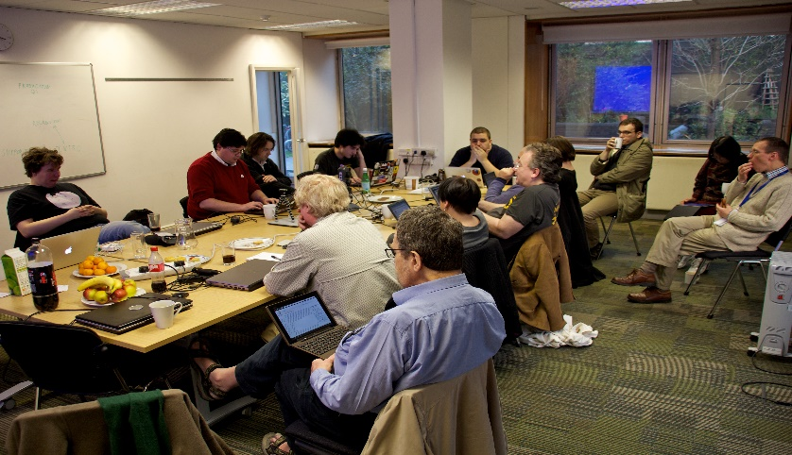
Looking Backwards
Regional Professional Development
February 23: Central Region – “Nimbly Interpreting and Using Assessment Results to Advance All Students Toward Achieving High-Quality Program and Institutional-Level Outcomes” with Dr. Peggy Maki @QCC
March 8: Boston Metro Region – “Academic Program Assessment” with Dr. Mark Nicholas, Framingham State @ Roxbury Community College
May 24: Southeast Region – “Civic Learning & Assignment Design Charrette” with Dr. Elizabeth Hardwood and Dr. Ruth Slotnick, Bridgewater State @ Massachusetts Maritime Academy
June 12: North Region – “Build Your Plan for Successful Assessment Practice” with Dr. Mark Nicholas, Framingham State @ UMass Lowell

Slide 8
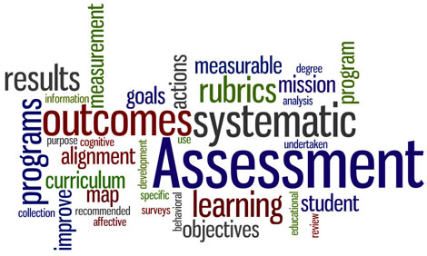
Looking Backwards
Multi-State Collaborative to VALUE Institute
Institutional Leaders Kickoff Meeting, Sept. 8: Guest Presenter - Dr. Michael Ben-Avie, Southern Connecticut State University
Refinement Year Results Presented (February 2018)
Refinement Year Redux (Matched Set) Presented (March 2018)
Areas of Focus: Critical Thinking and Quantitative Literacy
White Paper on Assessment Approaches Developed
Commissioner Santiago Agrees to Fund Two Years of VALUE Institute for Ten Institutions
Selection Guidelines Developed
Ten Institutions Selected

Slide 9
VALUE Institute Participating Institutions: 2018-2019
University of Massachusetts System
UMass Amherst
UMass Boston
State Universities
Salem State University
Community Colleges
Cape Cod Community College
UMass Lowell
Fitchburg State University
Westfield State University
Worcester State University
North Shore Community College
Northern Essex Community College
Eight out of ten categories of institutional types covered
Missing:
High tech. institution and high minorities (i.e., STCC)
Small institution with low minorities (e.g., Greenfield)
New participants:
UMass Boston
Cape Cod Community College (returning)

Slide 10
MassTransfer Pathways Student Learning Outcomes
Communication & Media Studies:
Human Communication
Interpersonal Communication
Film Studies
Media Studies
English:
American Literature
British Literature
College Writing I/English Composition I
College Writing II/English Composition II
World Literature
History (2 of 8):
Western Civilization I/II
Psychology (8 of 10):
Social Psychology
Child Development
Abnormal Psychology
Cognitive Psychology
Adolescent Development
Statistics for Psychology
Psychology of Personality
Brain and Behavior

Slide 11
Going Forward
Amcoa Team Meetings (all at QCC):
Fri., Sept. 28: “Institutional Assessment Program Panel: Learning from Our Peers”
Fri., Nov. 30: Dr. Patricia O’Brien, SND, Sr. Vice President, Commission on Institutions of Higher Education
Fri., Feb. 1: TBD
Fri., March 29: TBD
Task Force on Statewide Assessment (all at QCC):
Oct. 16: Dr. James Dottin, Chair, Business Administration Department, Middlesex Community College
Jan. 17: TBD
March 8: TBD
Eighth Annual Assessment Conference: Place and date TBD

Slide 12
Going Forward
Regional Professional Development
Assignment Design & Rubric Alignment Charrettes
Objectives: Improve student learning, links learning & teaching with assessment, better data, and equity
Expected Outcomes: Increase participation in VALUE Institute, create more effective assignments, and employ the use of TILT design
Targeted to faculty
Incentives for attendance: Hands-on session using their own assignment, held on Friday, travel expense reimbursed, textbook on assignment design, and food
Regionally located, i.e., West (Westfield State), Central (Worcester State), North (North Shore Community), Boston Metro (UMass Boston), and Southeast (TBD)
Fall 2018; 9am-12Noon
Use local assessment leaders as faculty

Slide 13
Going Forward
Regional Professional Development
Quantitative Literacy Workshops
Objectives: Addresses area of focus from Refinement Year MSC, improve student learning, expands the use of quantitative literacy across the curriculum, links learning & teaching with assessment, better data, and equity
Expected Outcomes: Create more effective assignments, employ the use of TILT design, and illustrate student utilization of quantitative literacy
Targeted to cross-discipline faculty
Incentives for attendance: Hands-on session using their own assignment, held on Friday, travel expense reimbursed, textbook on quantitative literacy, and food
Regionally located, i.e., West, Central, North, Boston Metro, and Southeast (Bridgewater State)
Support the SEQuel Conference at Bridgewater State
Spring 2019
Host guest speakers and showcase local faculty

Slide 14
Going Forward
Assessment Program Design One Day Workshop for Institutional Teams
Place (centrally located) and date TBD (Friday)
Focus will be on institutional teams of up to five to develop or strengthen their assessment program
Facilitator: Dr. Mark Nicholas, Executive Director of Institutional Assessment, Framingham State University
Food and refreshments to be provided

Slide 15
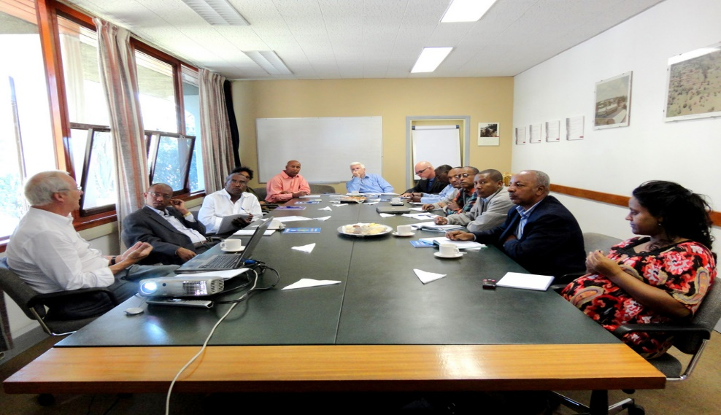
Looking Backwards
VALUE Institute
Institutional Leaders Kickoff Meeting, Sept. 14: Guest Presenter - Dr. Brian Doore, Unity College; formerly Director of Assessment, University of Maine
Area of Focus: Critical Thinking for 2018-2019, and 2019-2020
Continue Participation in the MSC National Steering Committee; MSC will be a sub-group within VALUE Institute
Data Analysis, Presentation, and Reporting by Two-Year and Four-Year Institutions

Slide 16
MassTransfer Pathways Student Learning Outcomes
Carryover from AY 2018
Business Administration
Criminal Justice
Early Childhood Education
New for AY 2019
Elementary Education
Engineering
Fine Arts & Graphics
Math

Slide 17
Going Forward
Open Educational Resources (OER) Working Group
Invite team members to the Working Group
Convene the Working Group
Conduct research
Develop an OER statewide policy and implementation plans
Gain approval of the statewide policy from the Board of Higher Education
Effect the policy and implementation plans

Slide 18
Questions…Comments?
Thank You!!

